Slide 1
Movielens Data Analysis
Notes:
Talk about the data

Slide 2
Movielens Dataset
Source: files.movielens.org/datasets/movielens/ml-100k
The movielens dataset is comprised of 100,000 movie ratings spread across 1682 movies by 943 users.
From this dataset we imported data.csv, genre.csv, and user.csv, item.csv into 4 tables that we named movie, genre, users, and item respectively.
movie | genre | users | item
user_id | genre | user_id | movie_id
item_id | id | age | movie_title
rating |  | gender | release_date
time_stamp |  | occupation | genres
Notes:
Talk about the data. Remove unused data mentions

Slide 3
Mission Statement
To see what theatrical elements work best in an given genre’s production (ex. action/comedy) based on existing well-performing releases.
To see what theatrical elements were more popular with the general public given statistically significant levels of ratings.
What users to market specific movies to in order increase popular sentiment towards new releases.
Notes:
Talk about mission statement (what we’re trying to do with the data)

Slide 4
Queries Ran
== What is the Title of the Top-rated Action and Comedy movie? ==
SELECT item.movie_title AS `movie title`, AVG(movie.rating) AS `avg rating` FROM movie, item WHERE movie.item_id = item.movie_id AND item.action = 1 AND item.comedy = 1 GROUP BY item.movie_title ORDER BY AVG(movie.rating) DESC LIMIT 1;
== What are the top 25 rated movies having at least 50 views? ==
SELECT item.movie_title AS `movie title`, AVG(movie.rating) AS `avg rating`, COUNT(movie.user_id) AS `views` FROM movie, item WHERE item.movie_id = movie.item_id GROUP BY item.movie_title HAVING COUNT(movie.user_id) >= 50 ORDER BY AVG(movie.rating) DESC LIMIT 25;
== What is the user with the highest average rating for a specific year? ==
SELECT user_id, avgrating, year, rank FROM(SELECT user_id, AVG(rating) AS avgrating, from_unixtime(time_stamp,'yyyy') AS year, RANK() OVER(ORDER BY AVG(rating) DESC) AS rank FROM movie GROUP BY user_id, from_unixtime(time_stamp,'yyyy')) movie WHERE rank = 1;
Notes:
What queries were going to run in the shell

Slide 5
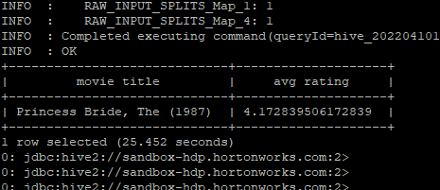
Output for Query 1
What is the Title of the Top-rated Action and Comedy movie?
Notes:
Output we get from the shell

Slide 6
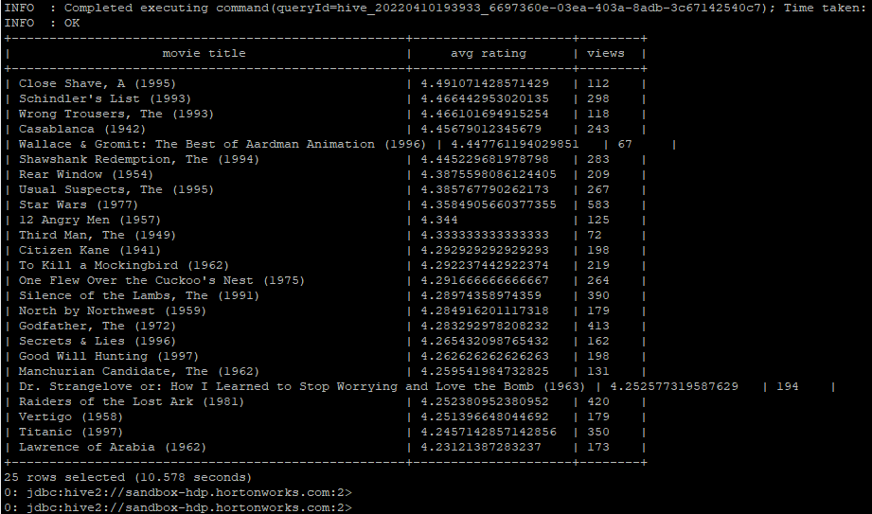
Output for Query 2
What are the top 25 rated movies having at least 50 views?

Slide 7
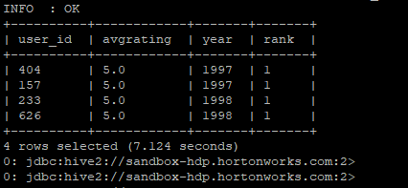
Output for Query 3
What is the user with the highest average rating for a specific year?

Slide 8
Interpretation of the Queries Ran
For action comedy movies, films elements with similar theatrical elements to movies such as The Princess Bride (1987) would likely be popular to the general public.
What the most popular movies that were heavily reviewed and watched in the given dataset were. Most of the films that garnered good reviews were action or thriller type movies.
What users to market new theatrical releases to/ give advanced copies to boost ratings before the film releases to the general public. For instance users 404, 157, 233, and 626 gave incredibly high average ratings for all movies watched in the years that they reviewed them.
Notes:
Interpret the output

Slide 9
Limitations and Improvements
Data set is too small to make any significant, accurate determinations of certain queries.
For instance each user only has 20 reviews spread across 2 years.
Even 100,000 ratings is too small to make precise and accurate statements about certain queries.
Data set is too incomplete.
There are other movies in that time period that were released.
Many more users that gave ratings for those movies as well.

Slide 10
Any questions?

